Slide 1
A real-time intrusion detection system based on
OC-SVM for containerized applications
Lu Zhang
MultiScale Networked Systems
University of Amsterdam

Slide 2
Background
Digital Data Marketplace (DDM) is a digital infrastructure that facilitates secure data exchange and federation
In a DDM, there is a unique identifier for each data and compute object
The parties agree on permissible actions on specific data and compute objects and express them into a policy
The DDM infrastructure implements policy enforcement components
    Preventative countermeasures
    An Intrusion Detection System (IDS) is essential

Slide 3
Architecture
  Monitor system calls generated by a running container
  One Class Support Vector Machine (OC-SVM) for anomaly detection
  Model retraining to adapt to dynamic characteristics of the application behavior
  The training data is collected in a secured environment and retraining data is analysed and sanitized
Notes:
The system call monitoring module gathers the system call traces with Sysdig
the streaming system calls are separated into segments before being mapped into feature vectors
Anomaly analysis module – provide guidance of risk of an amomaly
Match the system call sequences with existing attack database;
Check the neighboring segments of system call traces and determine whether this is a standalone anomaly or not;

Slide 4
One-class Support Vector Machine
Classic SVM: Find a hyperplane that separates the normal and abnormal data points with a maximized geometry margin by solving an optimization problem
Maps the input data points into a new feature space of higher or even infinite dimensions with kernel functions
  Linear Kernel
  Gaussian Kernel
Good at dealing with complex non-linear problems
One-Class SVM:
  An unsupervised learning algorithm and does not require any labelled training data
Notes:
reason:
Good performance in literature

Slide 5
Experimental Design
How does the OC-SVM based detection engine perform for detecting modern attacks?
Investigate the influence of different configurations
  Segmentation lengths
  Feature extraction methods
    term-frequency (tf )
    term frequency-inverse document frequency (tf-idf )
    ngram
  Kernel functions

Slide 6
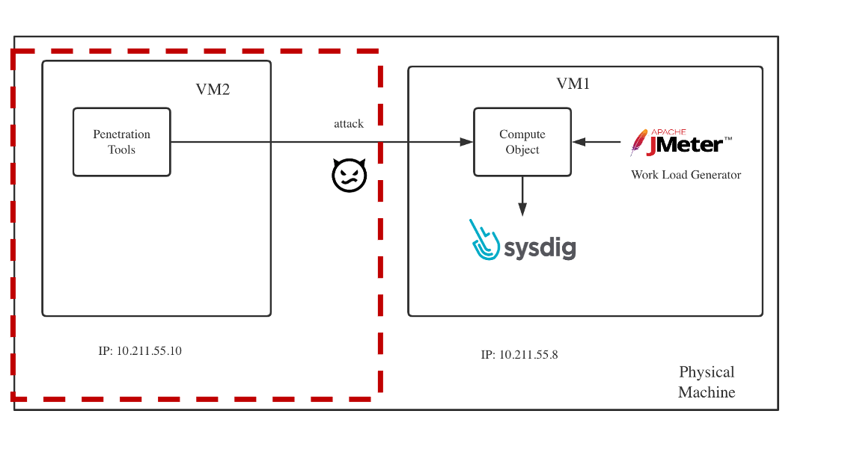
Experimental Dataset Construction
The performance of IDS learning algorithms highly depends on the statistical properties of the training dataset
Currently no public databases containing system call traces of container-specific applications or attacks
Dynamic Applications
    Many users interacting with the system
    Dynamic workload generation with Jmeter
    MongoDB, CouchDB
Static Applications
    Do not have many users involved and have a more constant execution path every time
    Train ML models
Notes:
1. Figure shows the experimental platform we built for generating normal and abnormal system call traces. To avoid the inferences of other user activities, we set up a Docker container running CouchDB or MongoDB server in a virtual
machine (VM1). Sysdig is implemented in the kernel space to collect system call traces generated by the running container
2. To simulate the dynamic behaviors of real-world database users, we send requests to the container from the same virtual machine (VM1). This is conducted with Apache JMeter, which is an open-source workload generation tool. For abnormal traces, we conduct attacks with exploitation tools, e.g Nmap and Metasploit, in another virtual machine (VM2).

Slide 7
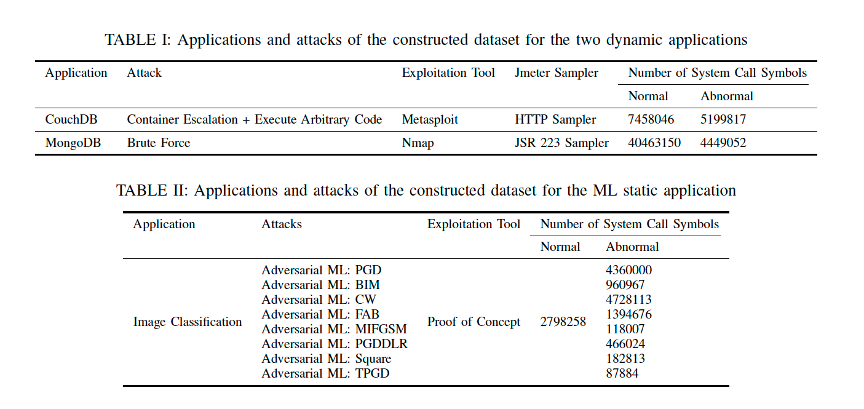
Experimental Dataset Construction

Slide 8
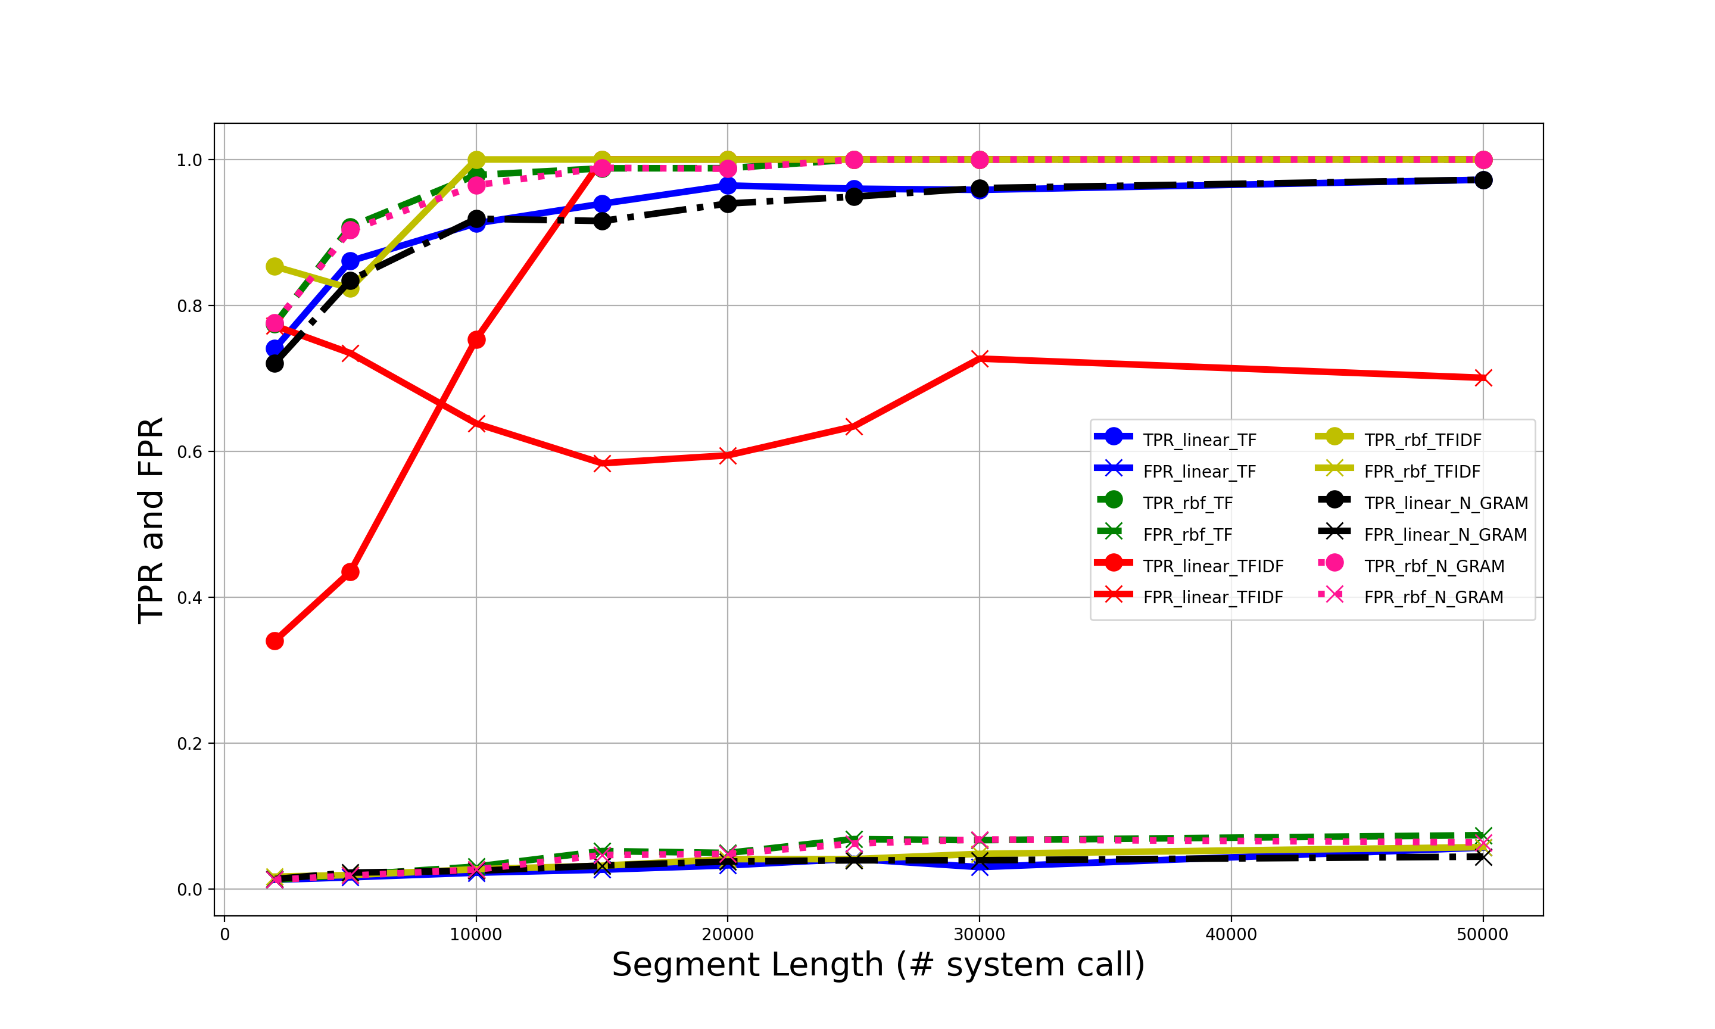
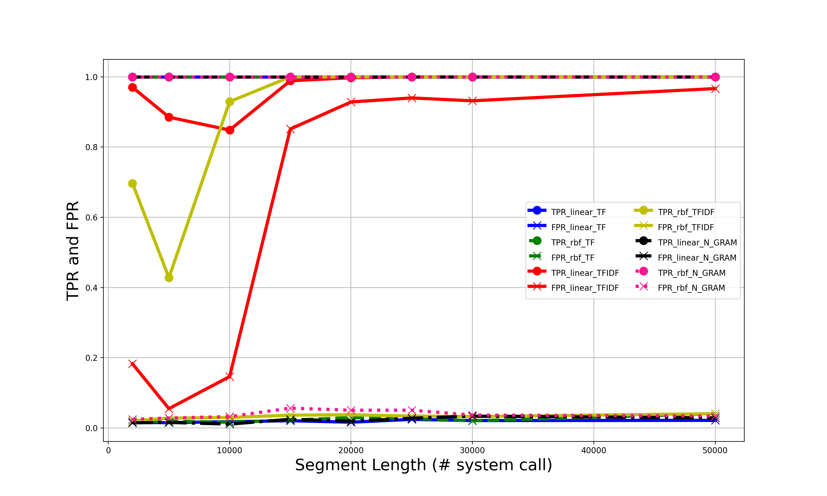
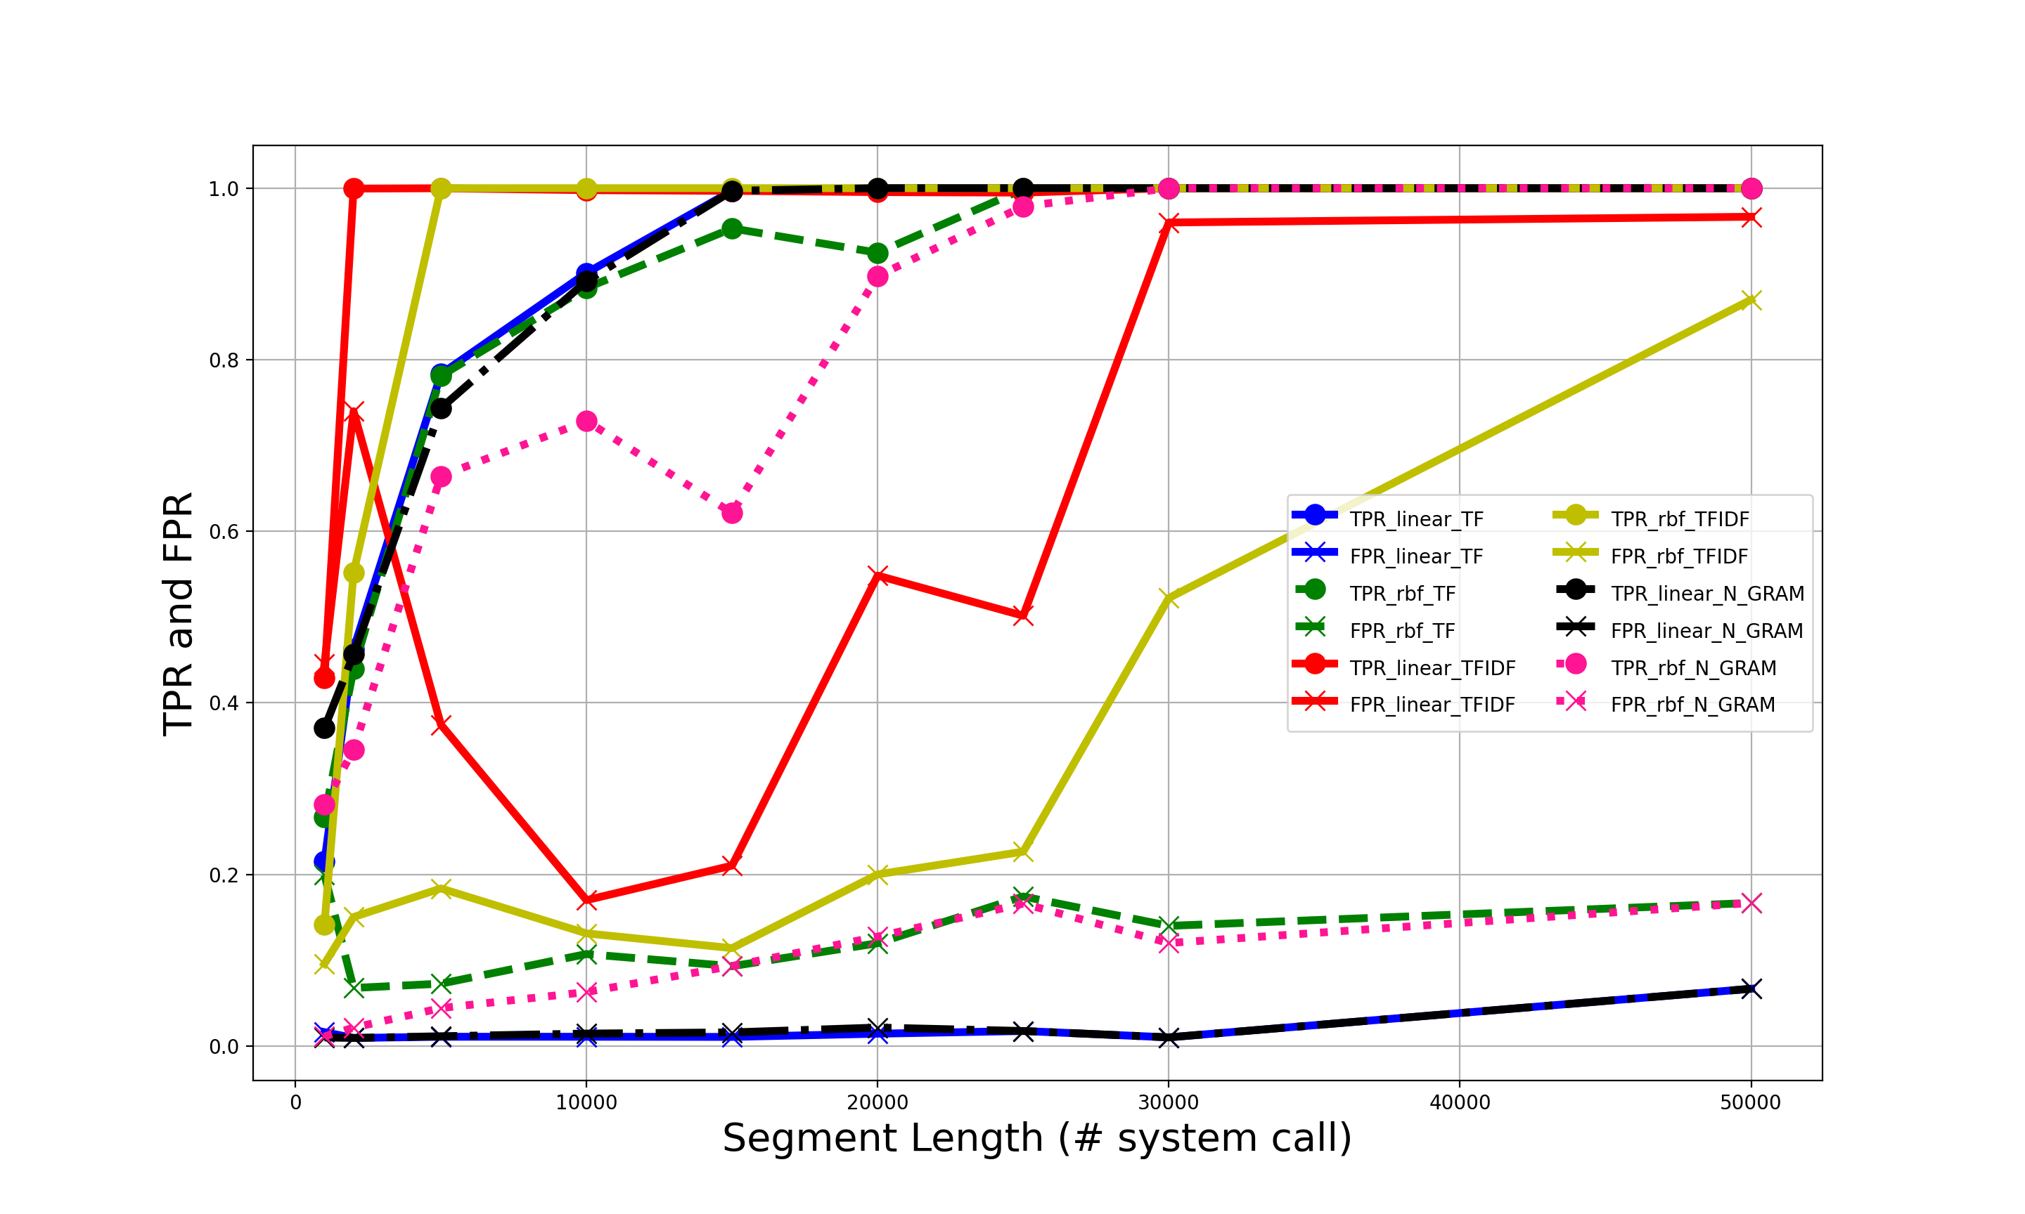
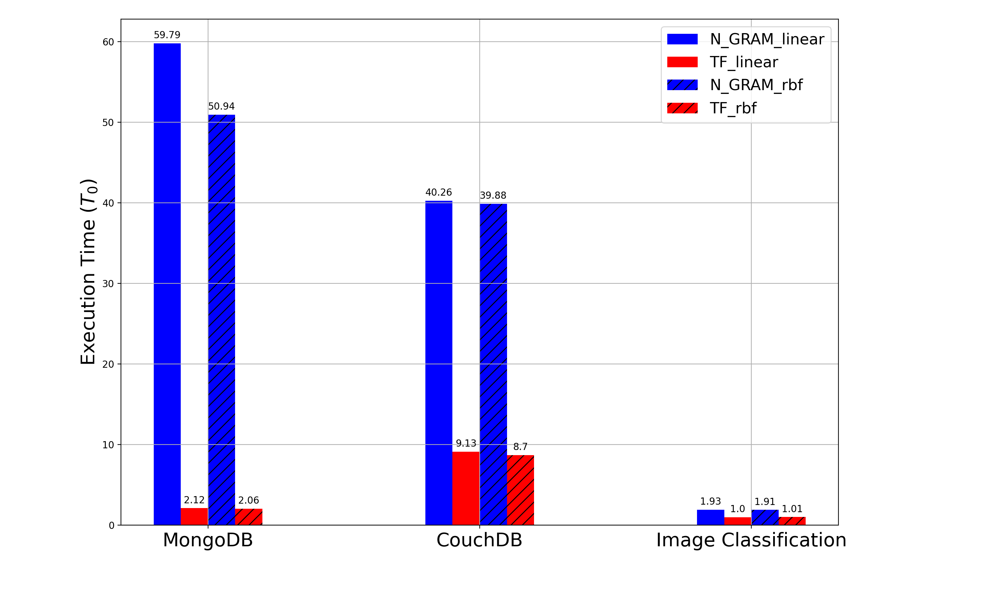
CouchDB and Arbitrary Code Execution Attack
MongoDB and Brute Force Attack
Image Classification and Adversarial ML Attack
Execution Time
Notes:
both TPR and FPR values show a growing trend with larger segmentation length values for all applications and features . The TPR converges to a value close to 1 and the total performance degrades with higher FPR if the segmentation length exceeds that point.
There is an optimal segmentation value exists. Based on the experiments, its 30000.
2 . For feature vectors: the feature tfidf performs significantly worse than the ngram and tf features for all applications, ngram and tf produce nearly identical results along various segmentation lengths for a given kernel.

Slide 9
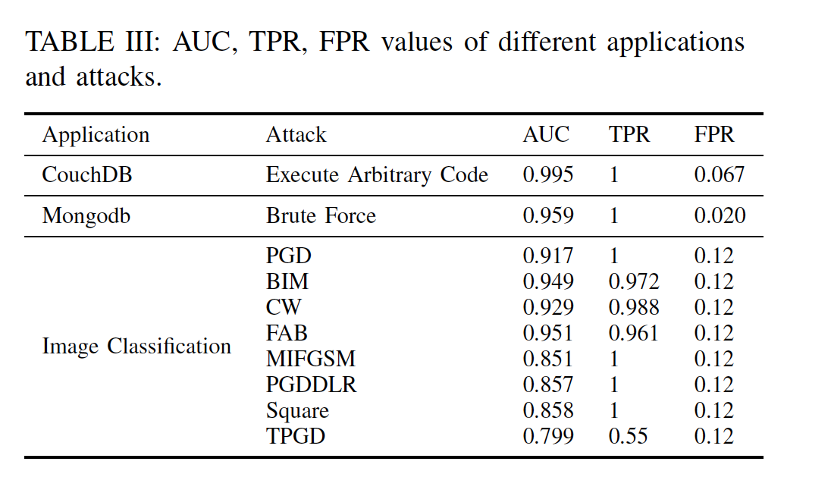
Experimental Results
Optimal Configuration:
  Feature extraction with tf
  Segmentation Length = 30000
  Gaussian Kernel
The attacks arbitrary code execution and brute force performed on dynamic applications are easier to detect.
More difficult to detect adversarial ML attacks who generates the adversarial samples in the runtime
Notes:
Table III summarizes the AUC, TPR and FPR values of the OC-SVM
algorithm for all applications and attack

Slide 10
Conclusions and future work
Propose an intrusion detection system based on OC-SVM
Establish a dataset containing system calls of modern attacks for containerized applications
  container escalation attack, brute force attack, adversarial ML attacks.
Accepted by conference CSE2021
Propose defence strategies for adversarial ML attacks for IDS

Slide 11
THANK YOU AND ANY QUESTIONS?
www.dl4ld.nl
www.dl4ld.net

